Slide 1

ROBOTIC ARM WITH APPLICATION CONTROL
PREPARED BY- 1.
2.
3.
4.
ROBOTIC ARM WITH APPLICATION CONTROL

Slide 2
OBJECTIVES
A robotic arm is a type of mechanical arm, usually programmable, with similar functions to a human arm; the arm may be the sum total of the mechanism or may be part of a more complex robot. The links of such a manipulator are connected by joints allowing either rotational motion (such as in an articulated robot) or translational (linear) displacement. The links of the manipulator can be considered to form a kinematic chain. The terminus of the kinematic chain of the manipulator is called the end effector and it is analogous to the human hand.
ROBOTIC ARM WITH APPLICATION CONTROL

Slide 3
As, the title describes the project – ROBOTIC ARM WITH APPLICATION CONTROL Let’s get the basics right..!
What is “a ARM” in terms of electronics ?
The end effector, or robotic hand, can be designed to perform any desired task such as welding, gripping, spinning etc., depending on the application. For example, robot arms in automotive assembly lines perform a variety of tasks such as welding and parts rotation and placement during assembly. In some circumstances, close emulation of the human hand is desired, as in robots designed to conduct bomb disarmament and disposal.
ROBOTIC ARM WITH APPLICATION CONTROL

Slide 4
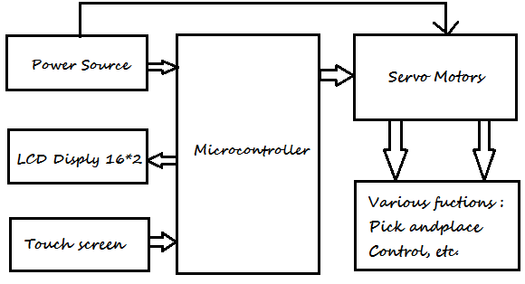
STRUCTURE OF THE PROJECT
ROBOTIC ARM WITH APPLICATION CONTROL

Slide 5
HARDWARE LIST
1. Arduino Uno r3
2. Servo motors
3. Touch screen
4. 9V Battery
5. Jumper wires
6 Connecting wires
7. External power supply
ROBOTIC ARM WITH APPLICATION CONTROL

Slide 6
SOFTWARE LIST
Arduino IDE
ROBOTIC ARM WITH APPLICATION CONTROL

Slide 7
APPLICATIONS
Access unevenly placed parts (for scanning, selecting...)
Pick and place (most industries, a lot for food industry)
Third hand: the arm carries the object and the operator can work on it easily
Act in a human-designed environment: send the arm on a mobile base to a damaged/radioactive building and use the arm to open the door and manipulate the tools (by itself or remote controlled)
Grasping and holding objects and then move them to a new location, or mixing with other fluids. (Used in laboratories that trust such arms to work within a toxic environment and so do not endanger the researcher.
ROBOTIC ARM WITH APPLICATION CONTROL

Slide 8
THANK YOU ☺
ROBOTIC ARM WITH APPLICATION CONTROL

